Slide 1

Regression Analysis using R

Slide 2
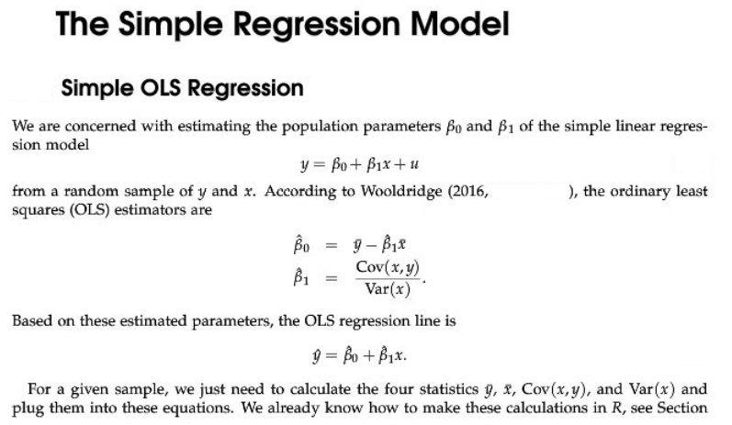

Slide 3
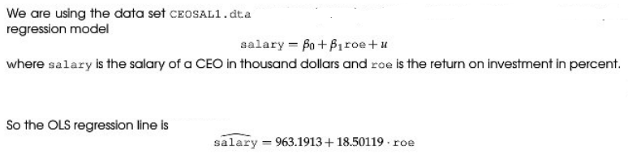
Wooldridge, Example: CEO Salary and Return on Equity

Slide 4
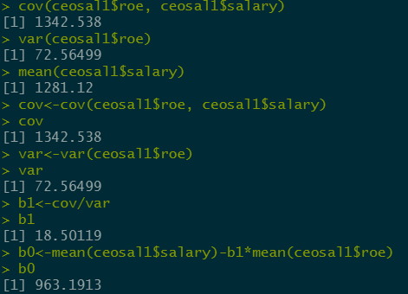
Output

Slide 5
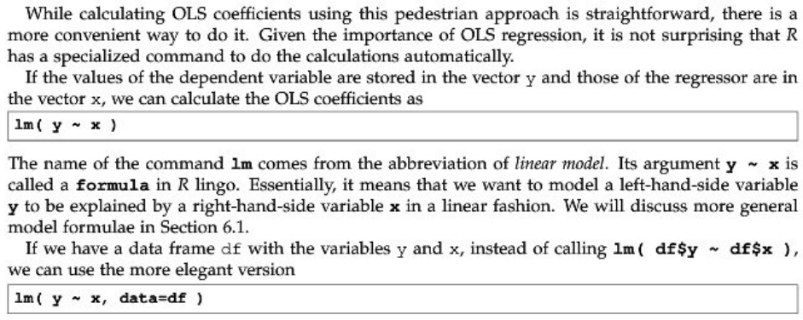
‘lm’ Function

Slide 6
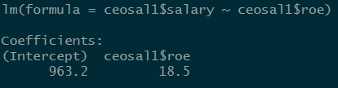
‘lm’ Function

Slide 7
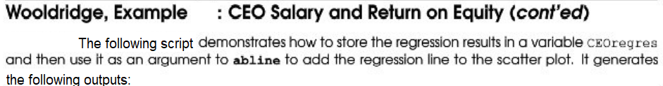

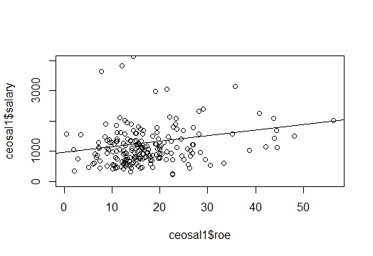

Slide 8
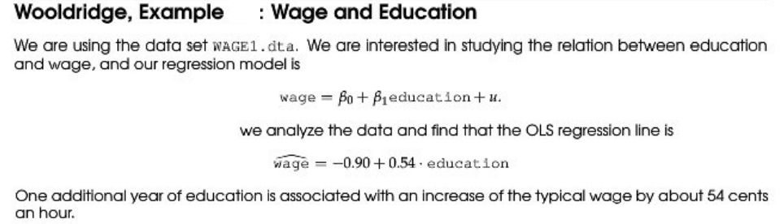

Slide 9
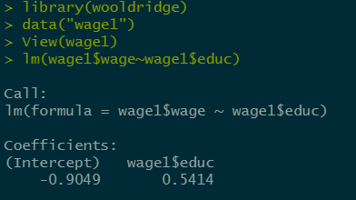
Example: Wage & Education

Slide 10
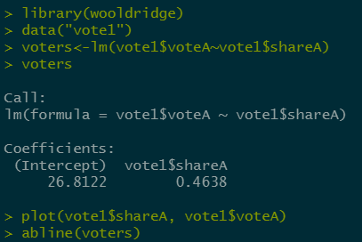
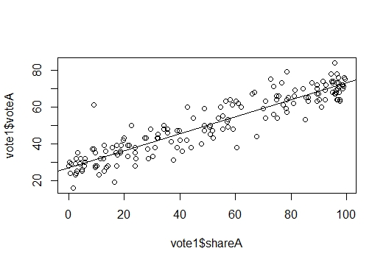
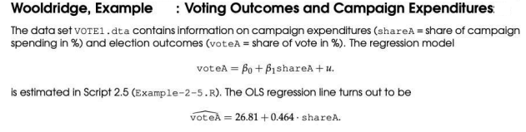

Slide 11

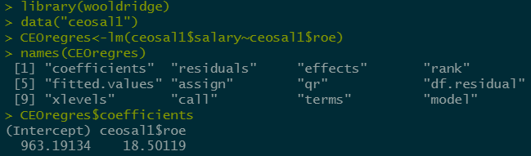

Slide 12
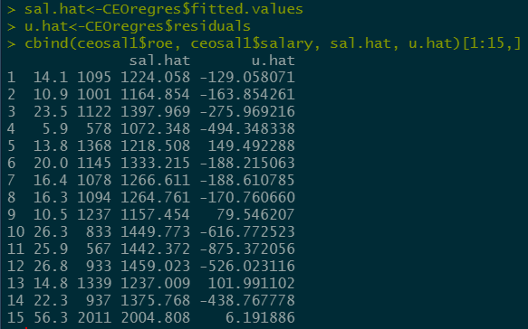
Wooldridge, Example: CEO Salary and Return on Equity
The regression example can be further extended. After the OLS regression, the fitted values and residuals can be calculated

Slide 13
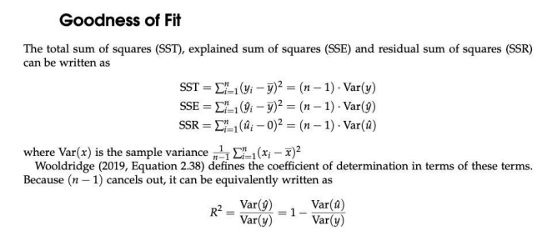

Slide 14
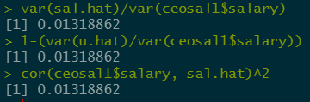

The value of $R^{2}$can be calculated in three different ways:

Slide 15
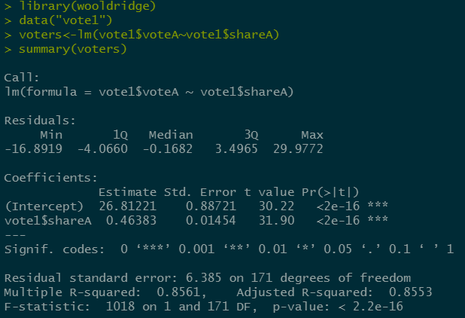

Slide 16
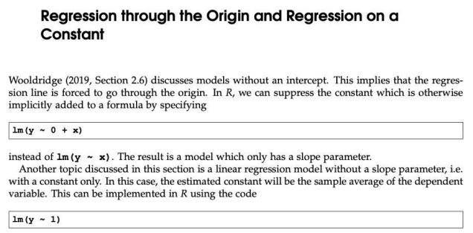

Slide 17
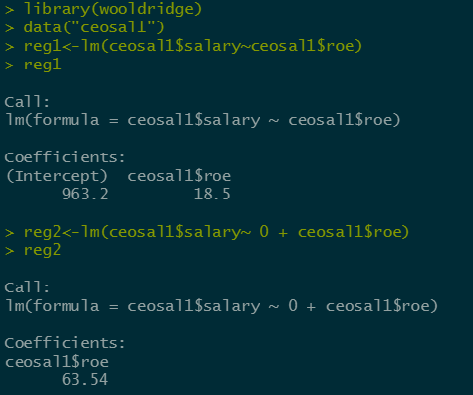
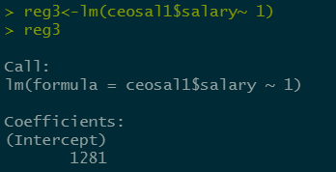
Output

Slide 18
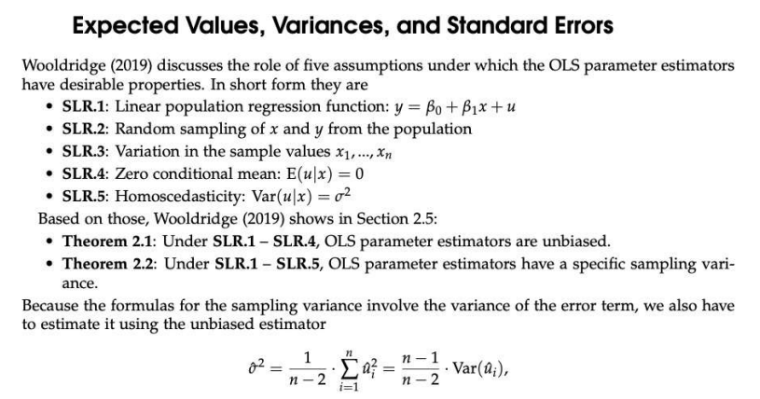

Slide 19
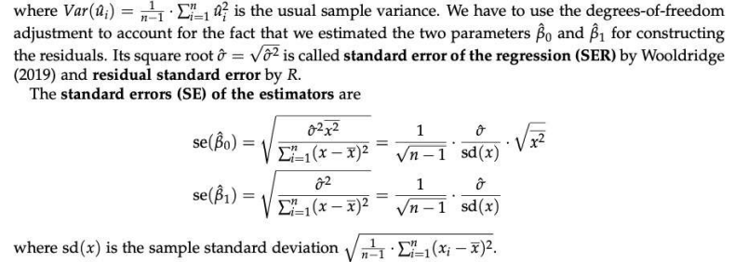

Slide 20
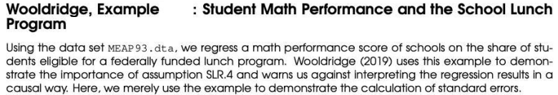

Slide 21
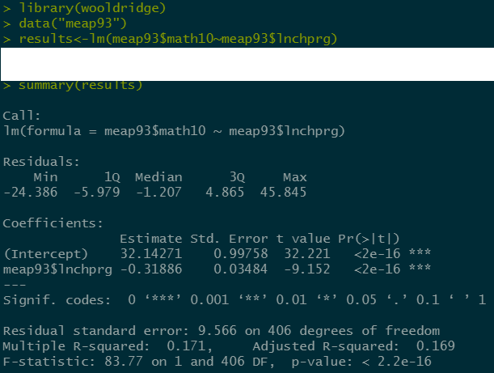

Slide 22
Assumptions of the Classical Linear Model (CLM)
So far, we know that given the Gauss-Markov assumptions, OLS is BLUE,
In order to do classical hypothesis testing, we need to add another assumption (beyond the Gauss-Markov assumptions)
Assume that u is independent of x₁, x₂,…, x_{k} and u is normally distributed with zero mean and variance s²: u ~ Normal(0,s²)

Slide 23
CLM Assumptions (cont)
Under CLM, OLS is not only BLUE, but is the minimum variance unbiased estimator
We can summarize the population assumptions of CLM as follows
y|x ~ Normal(b₀ + b₁x₁ +…+ b_{k}x_{k}, s²)
While for now we just assume normality, clear that sometimes not the case
Large samples will let us drop normality

Slide 24
The homoskedastic normal distribution with
a single explanatory variable
y
f(y|x)
.
.
E(y|x) = β₀ + β₁x
Normal
distributions
x₁
x₂

Slide 25
What is Heteroskedasticity
Recall the assumption of homoskedasticity implied that conditional on the explanatory variables, the variance of the unobserved error, u, was constant
If this is not true, that is if the variance of u is different for different values of the x’s, then the errors are heteroskedastic
Example: estimating returns to education and ability is unobservable, and think the variance in ability differs by educational attainment

Slide 26
Example of Heteroskedasticity
f(y|x)
y
.
.
E(y|x) = β₀ + β₁x
.
x₁
x₂
x₃
x

Slide 27
Why Worry About Heteroskedasticity?
OLS is still unbiased and consistent, even if we do not assume homoskedasticity
The standard errors of the estimates are biased if we have heteroskedasticity
If the standard errors are biased, we can not use the usual t statistics or F statistics or LM statistics for drawing inferences

Slide 28
Testing for Heteroskedasticity
Essentially want to test H₀: Var(u|x₁, x₂,…, x_{k}) = s², which is equivalent to H₀: E(u²|x₁, x₂,…, x_{k}) = E(u²) = s²
If assume the relationship between u² and x_{j} will be linear, can test as a linear restriction
So, for u² = d₀ + d₁x₁ +…+ d_{k} x_{k} + v) this means testing H₀: d₁ = d₂ = … = d_{k} = 0

Slide 29
The Breusch-Pagan Test
Don’t observe the error, but can estimate it with the residuals from the OLS regression
After regressing the residuals squared on all of the x’s, can use the R² to form an F or LM test
The F statistic is just the reported F statistic for overall significance of the regression, F = [R²/k]/[(1 – R²)/(n – k – 1)], which is distributed F_{k, n – k - 1}
The LM statistic is LM = nR², which is distributed c²_{k}

Slide 30
The White Test
The Breusch-Pagan test will detect any linear forms of heteroskedasticity
The White test allows for nonlinearities by using squares and crossproducts of all the x’s
Still just using an F or LM to test whether all the x_{j}, x_{j}², and x_{j}x_{h} are jointly significant
This can get to be unwieldy pretty quickly

Slide 31
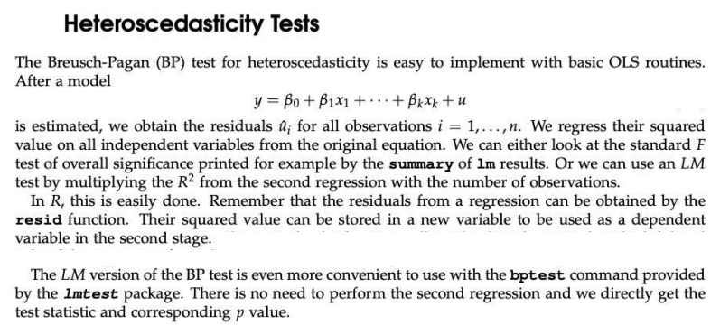

Slide 32
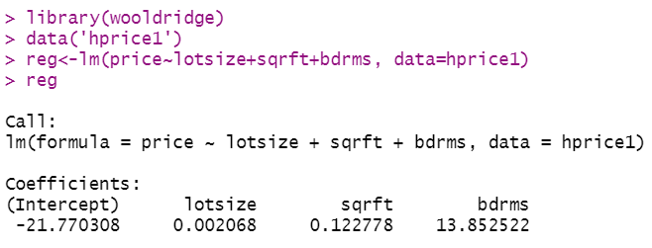
Heteroscedasticity in a Housing Price Equation

Slide 33
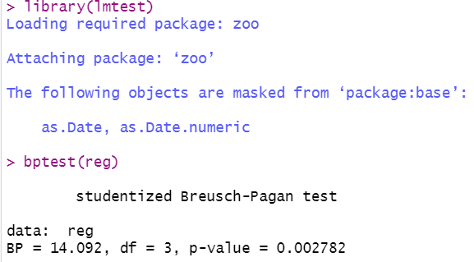
Heteroscedasticity in a Housing Price Equation

Slide 34
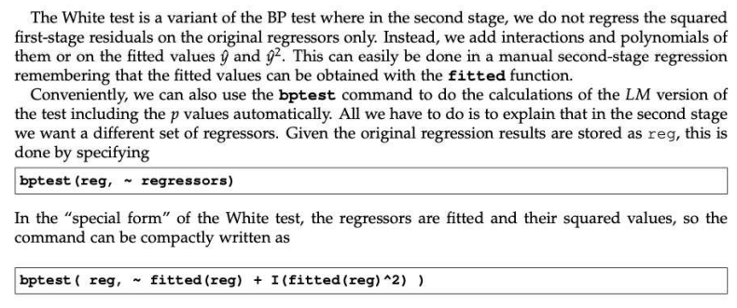
Heteroscedasticity in a Housing Price Equation

Slide 35
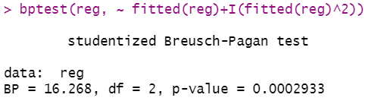
White test

Slide 36
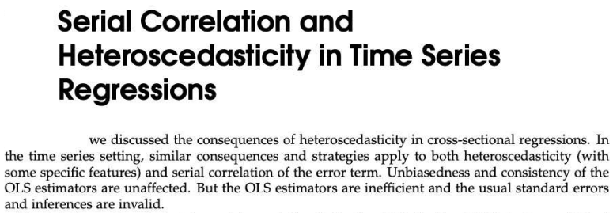


Slide 37
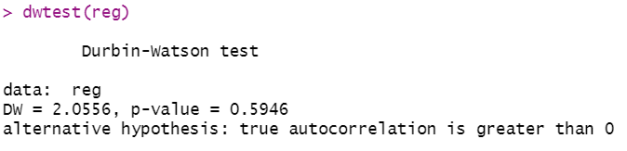
Durbin Watson Test

Slide 38
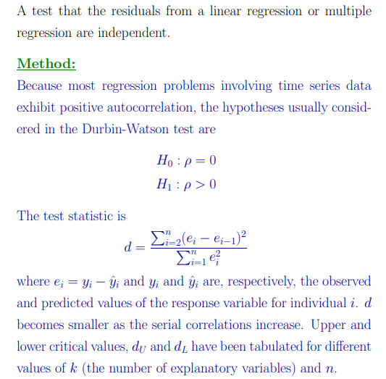
Durbin Watson Test

Slide 39
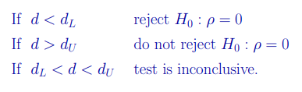
Durbin Watson Test

Slide 40
REMEDIAL MEASURES
What should we do if we detect heteroscedasticity?
Use method of Weighted Least Squares (WLS)
Divide each observation by the (heteroscedastic) σ_{i} and estimate the transformed model by OLS (yet true variance is rarely known).
If the true error variance is proportional to the square of one of the regressors, we can divide both sides of the equation by that variable and run the transformed regression.
Take natural log of dependent variable.
Use White’s heteroscedasticity-consistent standard errors or robust standard errors.
Valid in large samples

Slide 41
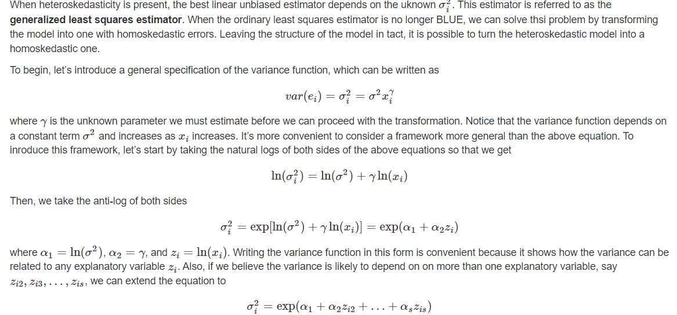
Generalized Least Squares With Unknown Form of Variance

Slide 42
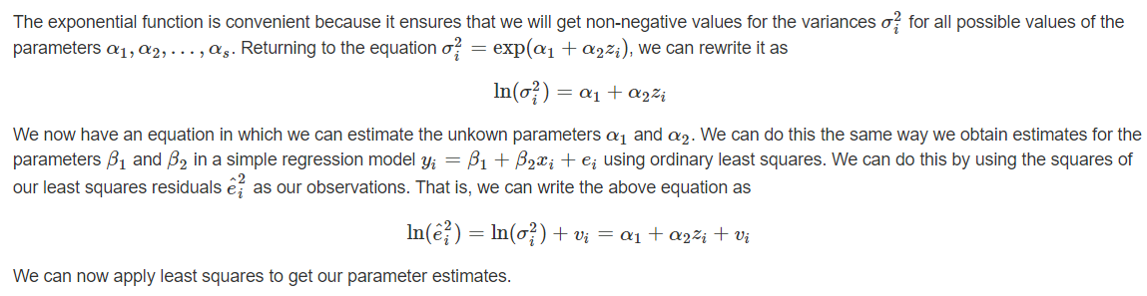
Generalized Least Squares With Unknown Form of Variance

Slide 43
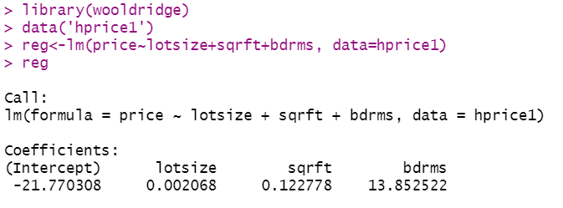
REMEDIAL MEASURES
Let’s use our ‘hprice1’ data that we’ve been working with so far.

Slide 44
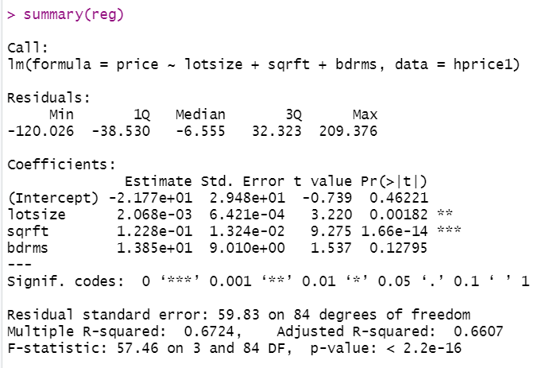
REMEDIAL MEASURES

Slide 45
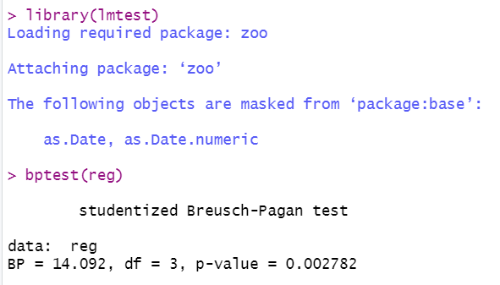
REMEDIAL MEASURES

Slide 46
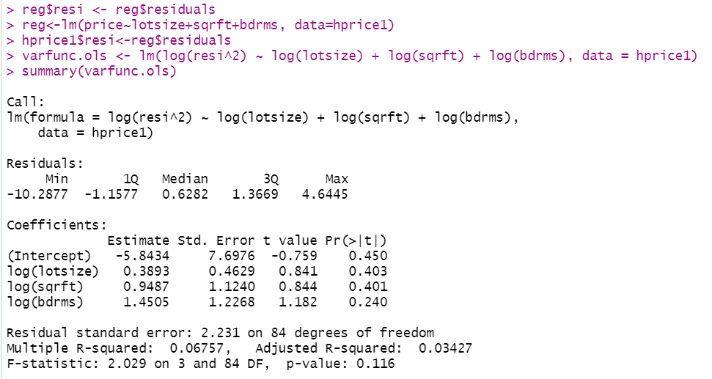
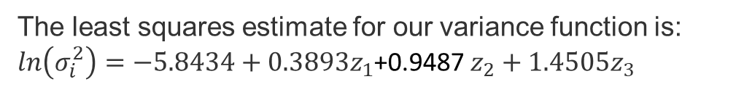
REMEDIAL MEASURES
The least squares estimate for our variance function is: $ln\left(σ_{i}^{2}\right)=−5.8434+0.3893z_{1}$+0.9487 $z_{2}+1.4505z_{3}$

Slide 47
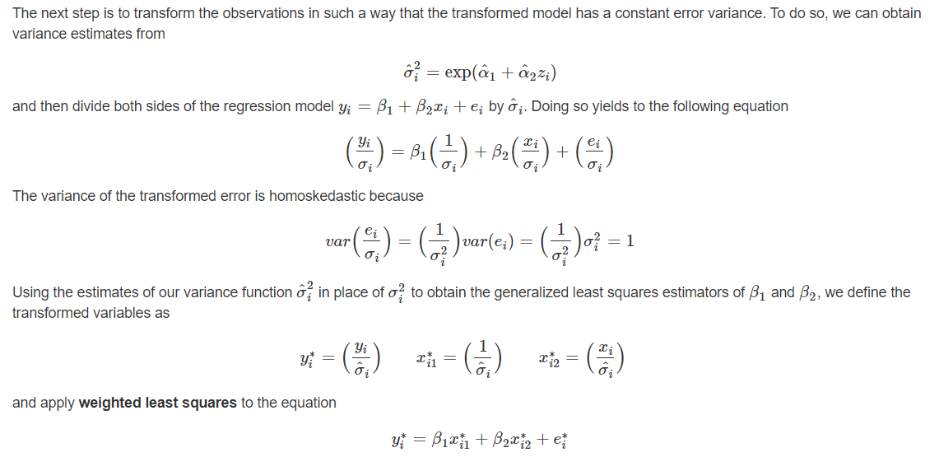
REMEDIAL MEASURES

Slide 48
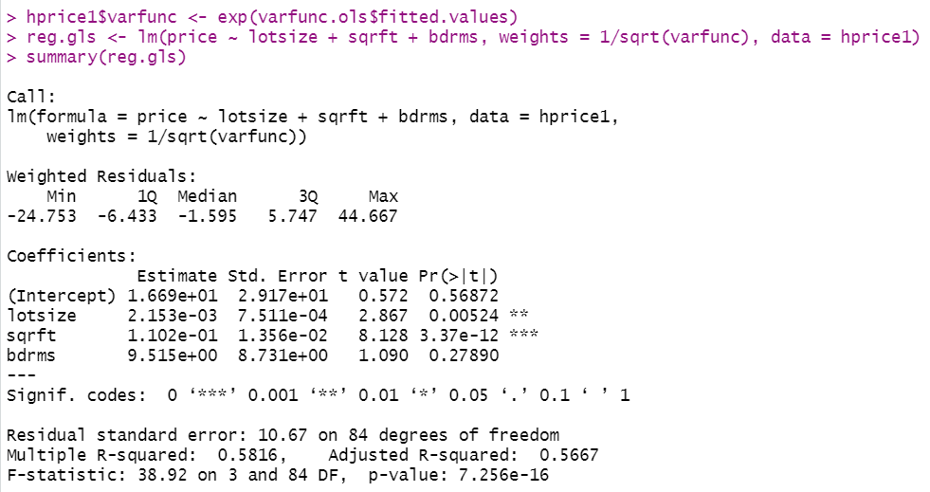
REMEDIAL MEASURES
Here’s how we can do it using R.

Slide 49
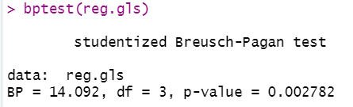

Slide 50
Box Cox Transformation
A Box Cox transformation is a transformation of non-normal dependent variables into a normal shape.
Normality is an important assumption for many statistical techniques; if your data isn’t normal, applying a Box-Cox means that you are able to run a broader number of tests.

Slide 51
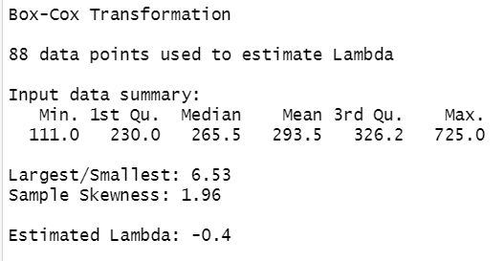
Box Cox Transformation
> library(MASS)
> library(caret)
> distBCMod=BoxCoxTrans(hprice1$price)
> distBCMod

Slide 52
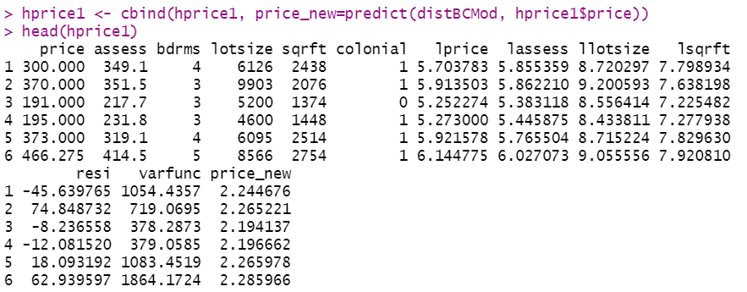
Box Cox Transformation

Slide 53
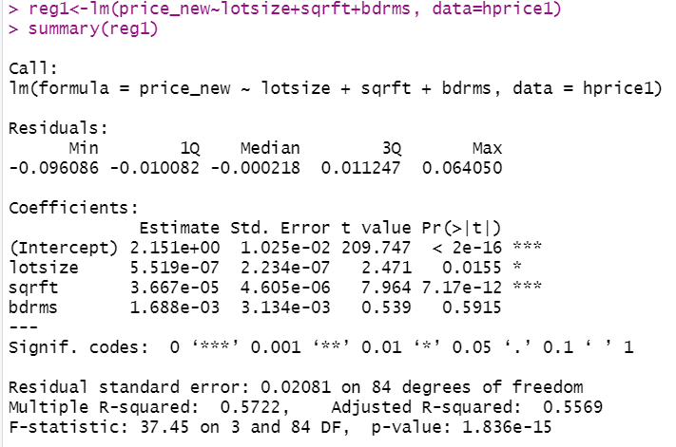
Box Cox Transformation

Slide 54
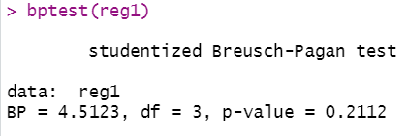
Box Cox Transformation

